Slide 1

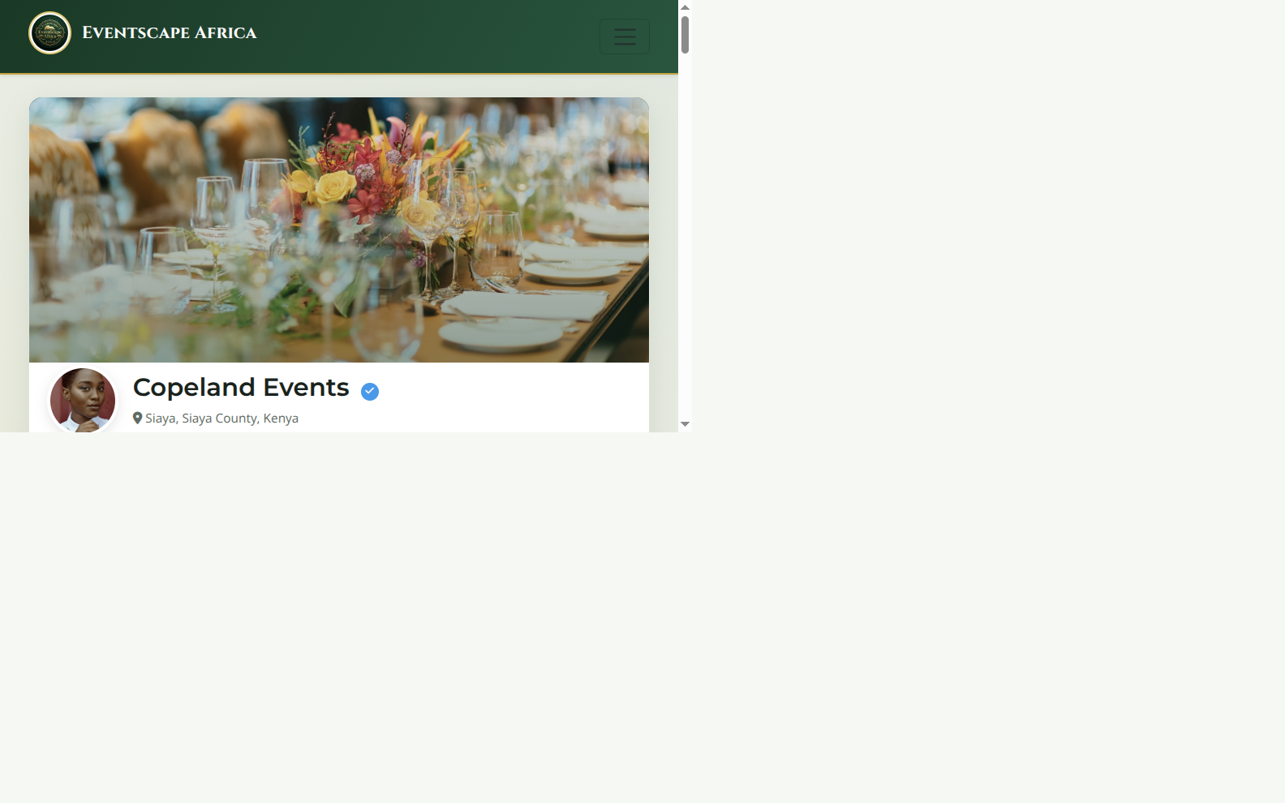
EVENTSCAPE AFRICA
PROVIDER GUIDE | EVENTSCAPE AFRICA
Turn your profile into a source of event leads
Showcase your services, receive better-briefed inquiries and manage every opportunity in one place.
A real product view from the developer demo
BE DISCOVERABLE · RESPOND · GROW
EVENTSCAPE AFRICA | SEPTEMBER 2026

Slide 2
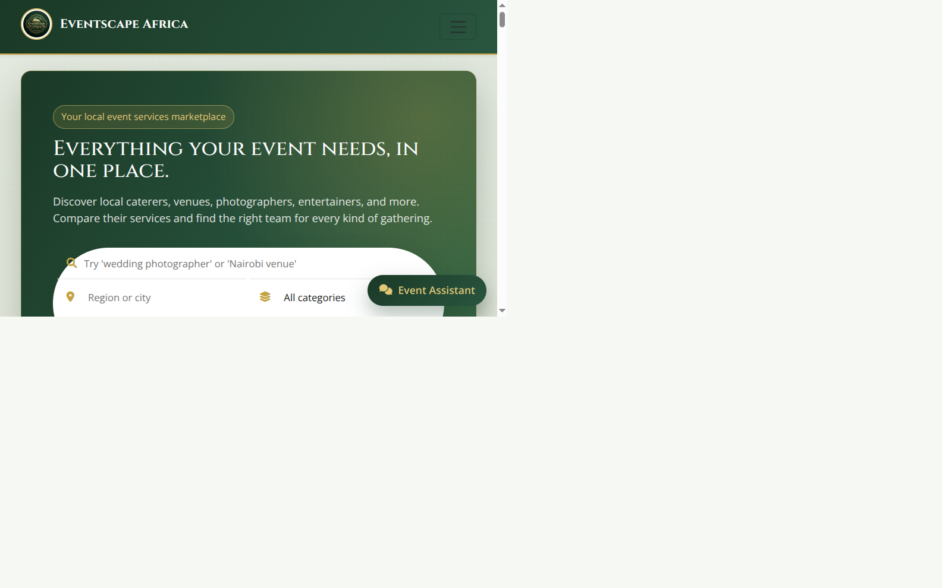
YOUR STOREFRONT
Make it easier for customers to find the right fit
Present your business, services and location in a marketplace built for events.
Customers can browse by:
• Service category and type
• Region or city
• Listing details and photos
• Provider profile and reviews
Clear details help customers send better inquiries.
EVENTSCAPE AFRICA
PROVIDER GUIDE
02

Slide 3
YOUR PROFILE
Turn a first visit into confidence
Your public profile brings your business identity and listings together.
Show customers the essentials
Business story
Display name, bio, photo and service area.
Services and media
Individual listings, descriptions, prices and portfolio images.
Reputation
Eligible customer reviews, provider replies and verified status when approved.
EVENTSCAPE AFRICA
PROVIDER GUIDE
03

Slide 4
HOW LEADS WORK
One event brief can start several provider conversations
Customers share context; providers handle availability, quotes and booking directly.
CUSTOMER
MATCH
INQUIRY
PROVIDER
Create a brief
Choose services
Send the request
Respond and agree
Event date, location, guest count and needs.
Browse listings and select suitable providers.
Message arrives as a lead with pricing context.
Continue the conversation and settle directly.
Eventscape does not process customer-to-provider booking payments. Agree and settle directly with your customer.
EVENTSCAPE AFRICA
PROVIDER GUIDE
04

Slide 5
YOUR WORKSPACE
Keep every opportunity moving
A lead pipeline and shared inbox help you follow up without losing the context.
NEW
VIEWED
RESPONDED
WON / LOST
A request arrives
Review the event details
Reply in the conversation
Record the outcome
Lead details
Shared inbox
Performance view
Keep the original message and price estimate attached to the inquiry.
Continue the customer conversation and see unread messages.
Track views, contact reveals, inquiries and response measures.
Analytics availability and depth depend on your plan; actual results depend on customer demand and provider follow-up.
EVENTSCAPE AFRICA
PROVIDER GUIDE
05

Slide 6
TRUST AND VISIBILITY
Build a reputation customers can evaluate
The platform makes trust signals visible and keeps paid placement transparent.
Verification
Customer reviews
Boosted placement
An approved badge is based on a verification record. It is not purchased with a plan.
Review eligibility is tied to an inquiry; providers can reply and report concerns.
Promoted results are labelled, limited and return to organic ranking after expiry.
No paid plan can buy verification, customer reviews or a guaranteed search position.
Keep your profile accurate, respond promptly and ask customers to use the platform’s inquiry flow.
EVENTSCAPE AFRICA
PROVIDER GUIDE
06

Slide 7
PLANS
Start free, then pay for more reach and insight
Current configured monthly prices and bundles. Annual plans are not available today.
FREE
STARTER
GROWTH
PREMIUM
KES 0
KES 500
KES 1,500
KES 4,500
3 listings
5 media per listing
Basic analytics
Unlimited listings and media
1 × 7-day search boost
Basic analytics
Unlimited listings and media
1 × 14-day search boost
Advanced analytics
Unlimited listings and media
3 × 21-day homepage boosts
Advanced analytics
Boosts improve visibility in a placement for a set time; they do not guarantee leads or a particular rank.
Prices and bundles reflect current app configuration and may change. Confirm the commercial offer before quoting.
EVENTSCAPE AFRICA
PROVIDER GUIDE
07

Slide 8
GET STARTED
A complete profile is your first growth tool
Set up the basics, publish a strong first listing and make every response count.
Complete your profile
Set your operating details
01
02
Business name, clear bio, photo and service location.
Service areas, working days, hours and blackout dates.
Publish a strong listing
Respond and learn
03
04
Accurate service description, price context, add-ons and quality media.
Reply to inquiries, update lead outcomes and review your performance.
Eventscape Africa | Create your provider profile and get your first service discovered.
The signup URL and final commercial terms should be added before distribution.
EVENTSCAPE AFRICA
PROVIDER GUIDE
08

